Slide 1

Redux thunk and react form
Lesson 12 – Mr. Minh Sang

Slide 2
Objectives
Understand Redux Thunk middleware return a function instead of an action
Use Formik and Yup for React

Slide 3

Redux Middleware and Redux Thunk

Slide 4
Redux Middleware
Provides the capability to run code after an action is dispatched, but before it reaches the reducer
Third-party extension point
e.g., logging, async API calls
Middleware:
Forms pipeline that wraps around the dispatch()
Pass actions onward
Restart the dispatch pipeline
Access the store state

Slide 5
Redux Middleware
Middleware typically used for:
Inspecting the actions and the state,
Modify actions,
Dispatch other actions,
Stop actions from reaching the reducers, etc.
The applyMiddleware() function:
Sets up the middleware pipeline
Returns a “store enhancer” that is passed to createStore()

Slide 6
Thunk
In programming, a thunk is a subroutine used to inject an additional calculation in another subroutine
Delay a calculation until its result is needed,
Insert operations at the beginning or end of the other subroutine
https://en.wikipedia.org/wiki/Thunk

Slide 7
Redux Thunk
Middleware that allows you to write action creators that return a function instead of an action
Can be used to delay the dispatch of an action, or
Dispatch only if a certain condition is met
Inner function receives the dispatch() and getState() store methods

Slide 8
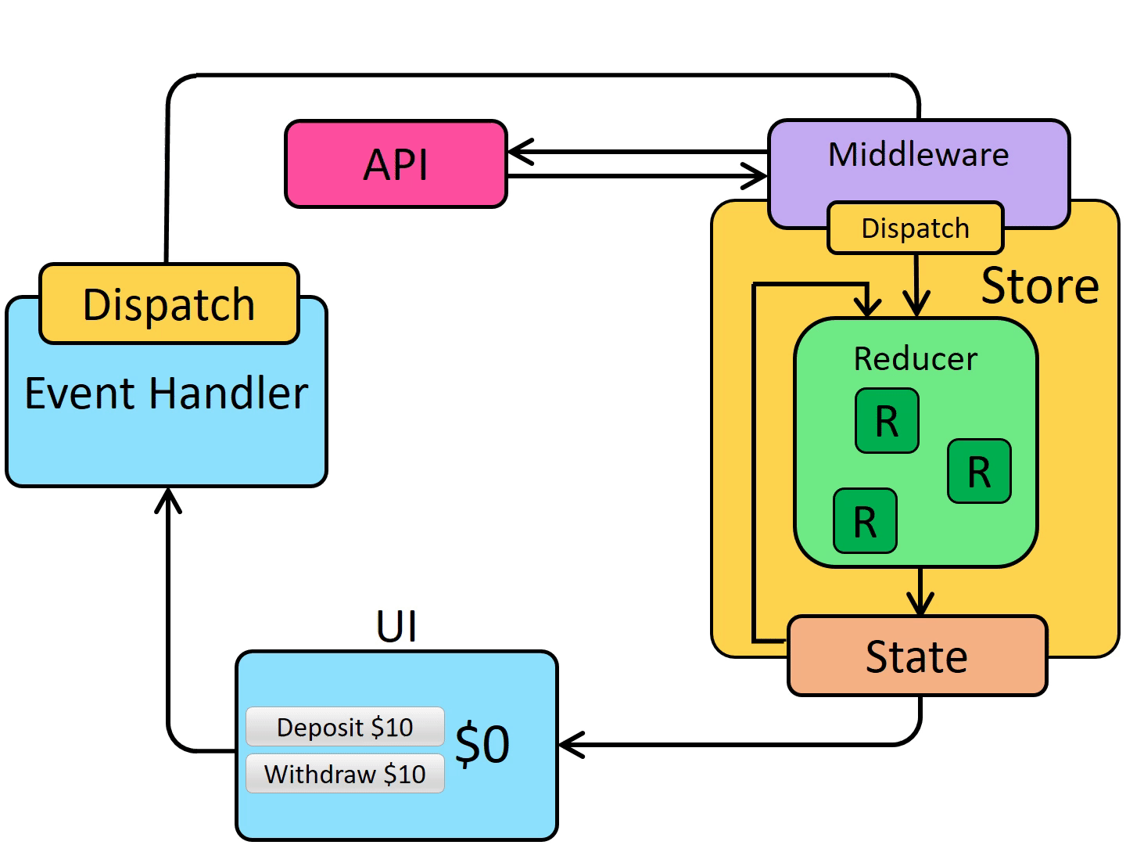
Redux Async Data Flow
https://redux.js.org/tutorials/fundamentals/part-6-async-logic

Slide 9
Redux Thunk
Useful for complex synchronous logic
Multiple dispatches
Conditional dispatches
Simple Async logic
Redux Saga: Uses ES6 generators to control pausable functions
Comples async logic
Ongoing “background thread” like processing behavior

Slide 10
Controlled Forms

Slide 11
Controlled Forms

Slide 12
Forms
Cohesive, effective and compelling data entry experience
Extensively used in websites and web applications for
Log in
Submit information (placing orders, booking a ticket etc.)

Slide 13
HTML Forms
Form Tag
<form> . . . </form>
Form elements:
<input>
type: text, password, submit, radio, checkbox, button, color, date, datetime, email, month, number, range, search, tel, time, url, week
<textarea>
<button>
<select>
These elements maintain their own state and update it based on user input

Slide 14
Controlled Components
Make the React component control the form that it renders:
Single source of truth
Tying the form state to component state
Controlled component
Every state mutation will have an associated handler function

Slide 15
unControlled Forms

Slide 16
Uncontrolled Components
Ideally you should implement forms within controlled components
Sometimes this approach may be too tedious
Uncontrolled component approach allows you to handle the form data by the DOM itself
Instead of writing an event handler for every state update, use a ref to get form values from the DOM
More easier to integrate React with non-React code

Slide 17
Formik and Yup for react form

Slide 18
Overview Formik
Formik is a small library that helps you with the 3 most annoying parts:
Getting values in and out of form state
Validation and error messages
Handling form submission
Install: npm install formik --save

Slide 19
Yup
Yup is a JavaScript schema builder for value parsing and validation.
Define a schema, transform a value to match, validate the shape of an existing value, or both.
Yup schema are extremely expressive and allow modeling complex, interdependent validations, or value transformations.
Install: npm install -S yup

Slide 20
Exercise 17: Redux and React Form Validation
Install and configure Formik and Yup.
Implement a controlled form using Formik.
Configure and implement simple form validation for controlled forms designed using Formik and Yup

Slide 21
Summary
Understand what Redux Thunk middleware is.
How to create controlled React forms and perform form validation.

